Slide 1







MINI ARCADE

Slide 2


LET’S BEGIN !
MANAN SHIRODKAR 1262253237
SOMYA KHARE 1262251880
ANANYA VANDEKAR 1262253423
GAUTHAM SUNIL 1262250367
RAGHAVENDRA SINGH 1262251359
UNDER THE GUIDANCE OF
PROF . SHIRISH PAYGUDE
PROF . ANURADHA NAGARE

Slide 3


Mini Arcade is a collection of multiple mini games
01
INTRODUCTION
Developed using C programming language
02
Console-based, menu-driven application
03
Combines entertainment with programming concepts
04
Helps in understanding logic building and teamwork
05

Slide 4
PROBLEM STATEMENT
To design and develop a console-based arcade system in C language that allows users to play multiple simple games using basic programming concepts in an interactive and menu-driven format.

Slide 5
OBJECTIVES AND TECHNOLOGIES
01
Apply C programming concepts practically.
01
Language: C
IDE: VS Code
02
Develop multiple games in one application.
02
03
Improve problem-solving skills.
03
Compiler: GCC / Min GW
04
Learn modular programming.
04
Platform: Linux

Slide 6


INDIVIDUAL CONTRIBUTION
THE PROJECT CONSISTS OF THE FOLLOWING GAMES:
NAME | WORK
MANAN SHIRODKAR | TOWER OF HANOI & TIC-TIC-TOE
SOMYA KHARE | HANGMAN,CONNECT FOUR, REPORT & PPT
ANANYA VANDEKAR | SUDOKU,NUMBER MEMORY, WORD JUMBLE, REPORT & PPT
RAGHAVENDRA SINGH | SNAKE & FRUIT
GAUTHAM SUNIL | MINESWEEPER,CALC GAME & ROCK-PAPER-SCISSORS

Slide 7
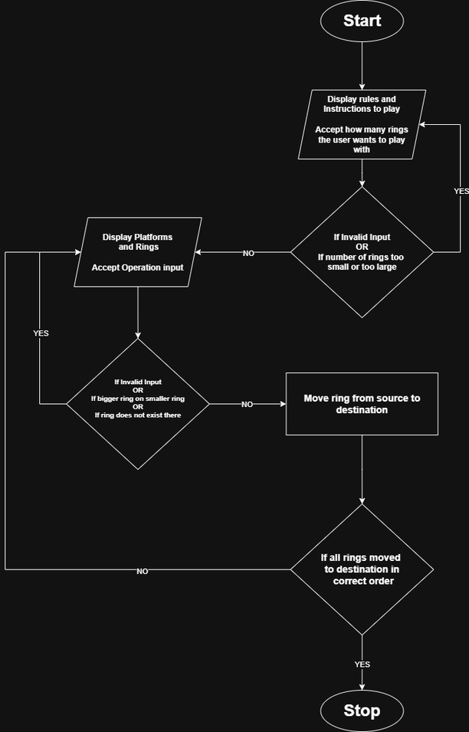
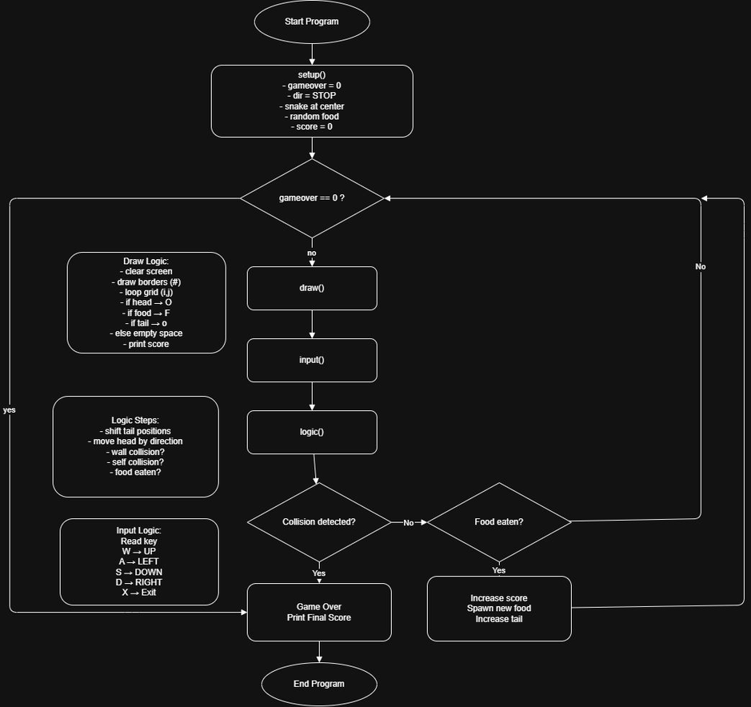
FLOWCHARTS
TOWER OF HANOI
TIC-TAC-TOE

Slide 8
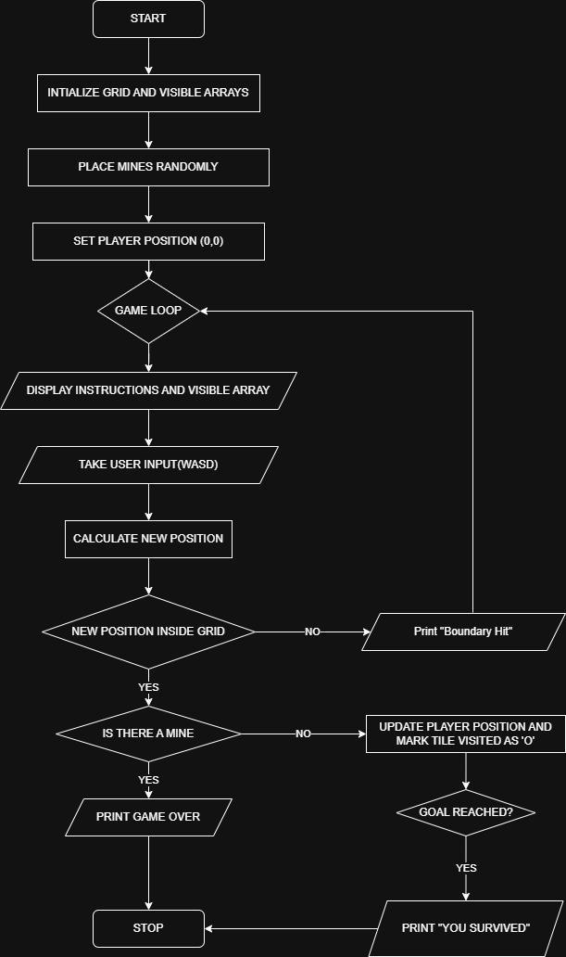
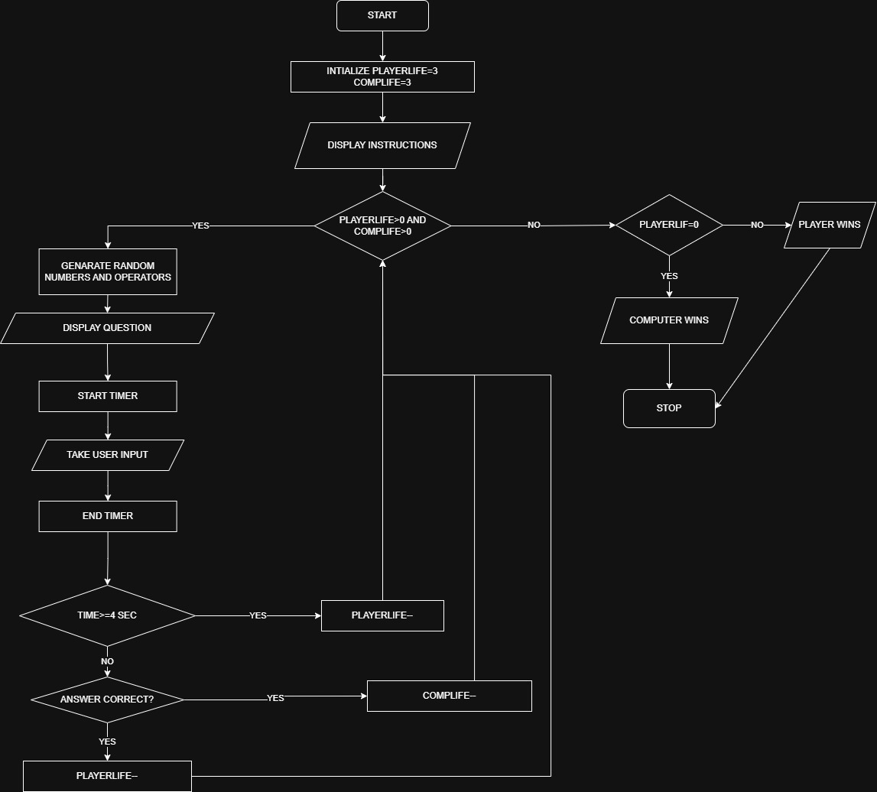
MINESWEEPER
CALC GAME

Slide 9

SNAKE & FRIUT

Slide 10
KEY FEATURES
01
Menu-driven interface
Uses functions for modular design
Interactive and user-friendly
Uses arrays, loops, conditions, and strings
Easy to extend with more games
02
03
04
05

Slide 11
CONCLUSION
01
Arcade Games project successfully implements C concepts
Enhances coding skills and logical thinking
Encourages collaborative development
Add more games
Store scores using file handling
Improve interface and difficulty levels
02
03
& FUTURE SCOPE
01
02
03

Slide 12



REFERENCE
01
Vs CODE
02
W3Schools & GeeksforGeeks for C Concepts

Slide 13


THANKYOU

